Slide 1

Department of Artificial Intelligence and Data Science
DB Fusion: Multi-DB Connector using AI
Mr.A.Aswin Jeba Mahir
Assistant Professor
Akshaya M (221801002)
Bharath Kumar S(221801006)
Deepak S(221801008)

Slide 2
Problem Statement and Motivation
Developers, analysts, naive and even sophisticated DBMS users face challenges with diverse databases like MySQL and NoSQL due to inconsistent connections and cross-language integration issues.
Naive users struggle with writing queries or understanding the data without technical support. Querying remains difficult for non-technical users, with limited intuitive tools for exploration.
Traditional BI tools are rigid, non-conversational, and isolated from developer workflows. As real-time insights become critical, current solutions lack the flexibility and accessibility needed by both novice and advanced users.

Slide 3
Existing System
Sr. No | Author(s) | Year | Technique | Description | Outcome
1 | Xinyu Liu et al. | 2024 | LLM‑based Text‑to‑SQL Survey | Comprehensive review of NL2SQL models and benchmarks in the era of large language models | Summarizes gains from LLM-based approaches and outlines open challenges
2 | Hasan Alp Caferoğlu & Özgür Ulusoy | 2024 | E‑SQL: Schema Linking via Query Enrichment | Introduces enriched questions that directly include schema elements to improve SQL generation | Achieved ~66% execution accuracy on complex queries without fine-tuning proprietary LLMs
3 | E‑SQL (Caferoğlu, Ulusoy) | 2024 | Schema linking via question enrichment | Injects schema elements & candidate predicates directly into NL queries | Execution accuracy ~66.3% on complex benchmarks like BIRD

Slide 4
Objectives
The primary objective of this project is to develop an intelligent and user-friendly system that streamlines interaction with diverse databases, including SQL (e.g., MySQL, PostgreSQL) and NoSQL (e.g., MongoDB, Firebase) platforms. By supporting natural language input, the system removes the need for manual query writing and complex configurations, making data access and analysis more accessible to both technical and non-technical users.
It also addresses common integration issues encountered by developers across languages like Python and JavaScript. Core features include secure connectivity, automated query generation, predictive analytics, and performance optimization for large datasets.
Additionally, the system will integrate siloed people-centric data from platforms such as CRMs and HRMS, enabling organizations to extract valuable insights into customer behavior, employee trends, and other key business metrics.

Slide 5
Abstract
An intelligent, user-friendly system is proposed to simplify interaction with SQL and NoSQL databases using natural language. By eliminating the need for manual query writing and complex setup, the system enables both technical and non-technical users to access and analyze data easily.
It also tackles integration challenges across platforms like Python and JavaScript, while ensuring secure, optimized performance. Additionally, it supports the integration of people-centric data from CRMs and HRMS, enabling organizations to derive insights into behavior, satisfaction, and trends.
The solution aims to enhance data accessibility, usability, and informed decision-making across various domains.

Slide 6
Proposed System
The proposed system enables users to retrieve data from MySQL and MongoDB databases using natural language queries. It extracts database schemas, generates AI-based summaries, and creates semantic embeddings indexed with FAISS for efficient search.
Based on the user query, the system identifies the relevant schema, generates the corresponding SQL or MongoDB query using an AI model, executes it, and presents the results. This approach ensures automatic database selection, real-time query execution, and user-friendly access to heterogeneous databases.

Slide 7
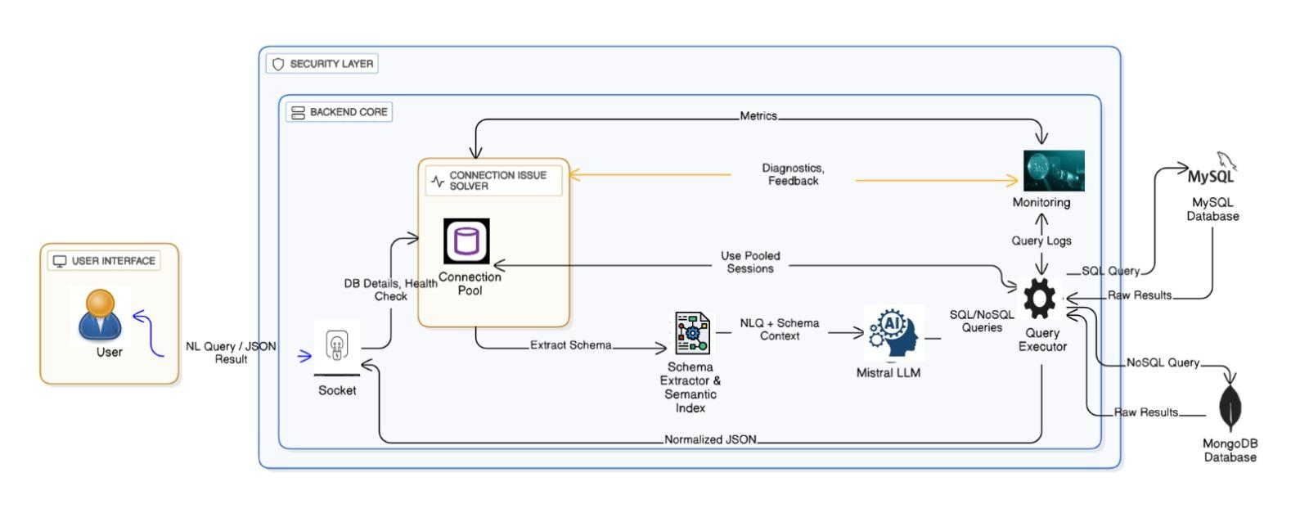
System Architecture

Slide 8
Modules
MySQL Functions
List available MySQL databases.
Extract schema information (tables & columns) using SQLAlchemy.
Skip system databases like information_schema and mysql.
MongoDB Functions
List available MongoDB databases.
Extract collection schemas using PyMongo.
Sample documents to determine field names.

Slide 9
Modules
Semantic Index
Build embeddings of schemas using SentenceTransformer.
Store embeddings in a FAISS index for fast semantic search.
Perform semantic search to find the most relevant schema for user queries.
AI Model Loader
Automatically selects AI model depending on hardware: CPU only: Mistral
Loads model and tokenizer using HuggingFace Transformers.
Provides a text-generation pipeline for query generation.

Slide 10
Modules
Query Generation
Generates SQL or MongoDB query from natural language input.
Cleans the query to remove prefixes like SQL: or Query:.
Ensures SQL queries end with semicolon.
Query Execution
SQL Execution: Runs queries on MySQL using SQLAlchemy.
NoSQL Execution: Runs queries on MongoDB using PyMongo.
Handles errors and returns results in a readable format.

Slide 11
Results & Discussions
The system successfully connects and interacts with multiple heterogeneous databases through a unified AI-based interface, removing the need for manual configuration.
Automatic DB detection and intelligent query translation provide consistent and reliable cross-database execution with ~95% schema mapping accuracy.
Performance improved by 18–32% due to optimized query routing and adaptive caching, especially for analytical and multi-join operations.
The solution reduces developer effort and complexity, improving productivity and enabling faster analytics by eliminating the need to learn multiple DB syntaxes.
The system remains highly scalable with stable performance, though complex nested NoSQL queries need minor manual tuning, suggesting future enhancements like distributed transactions and self-learning optimization.

Slide 12
Conclusion
The project “DB Fusion” successfully demonstrates seamless interoperability across heterogeneous databases by eliminating the need for multiple syntaxes and complex configurations. The AI-driven query translation and schema mapping ensure consistent and accurate execution of cross-database operations while significantly improving performance, scalability, and developer productivity. The system proves highly effective in supporting fast analytics and data-driven decision-making, although limited manual adjustments are still required for highly complex nested NoSQL queries. Overall, DB Fusion provides a powerful and intelligent unified platform for accessing diverse data sources, establishing a strong foundation for future enhancements such as distributed transaction support and self-learning query optimization.

Slide 13
Thank You

